Slide 1

Welcome To Module 1
Understanding
Microsoft Windows

Slide 2




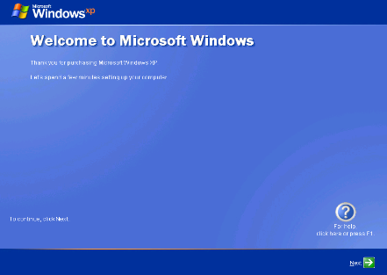



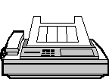

What is Windows?
Windows is an Operating System which sits in the middle of your hardware and users
By: Imran Afzal

Slide 3
Different Versions of Windows
Wikipedia:
https://en.wikipedia.org/wiki/List_of_Microsoft_Windows_versions
By: Imran Afzal

Slide 4
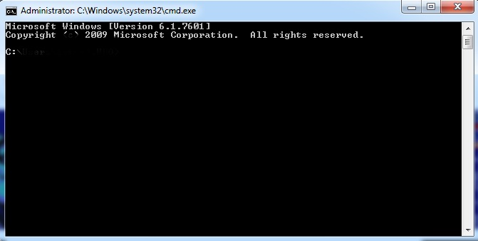
Microsoft Background and Products
Windows is owned Microsoft
Microsoft is co-founded by __________and Paul Allen on April 4, 1975
Microsoft started the OS with MS-DOS
By: Imran Afzal

Slide 5
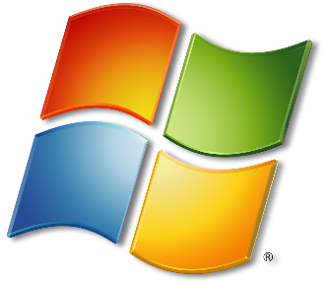
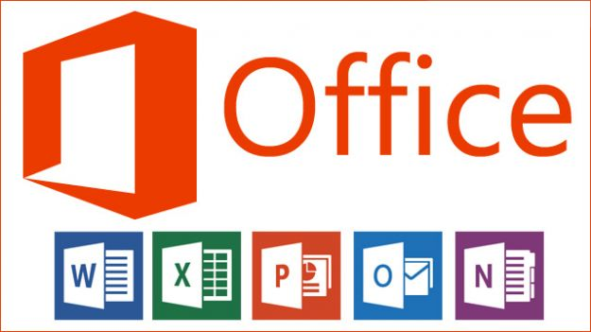
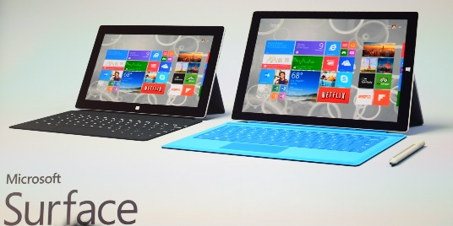


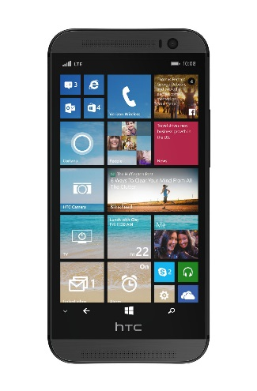
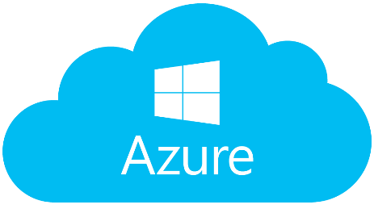






Microsoft Products
Windows
Windows Phone
By: Imran Afzal

Slide 6
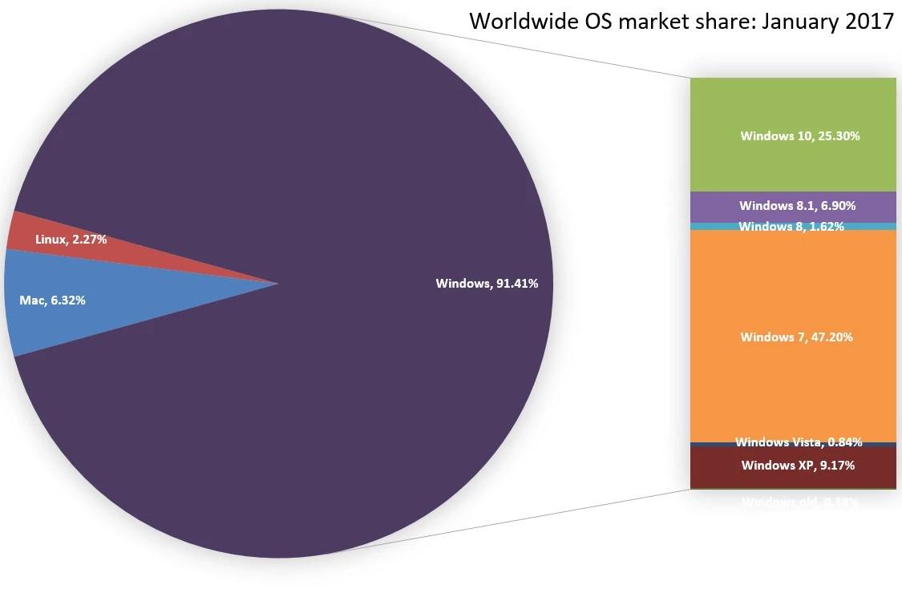
Windows Market Share
By: Imran Afzal

Slide 7

















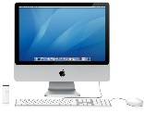
Windows vs. Linux vs. MAC
Windows
MAC
By: Imran Afzal

